Slide 1
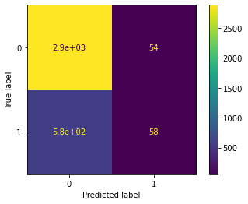
Waze Analytics Project: Predicting User Churn Using Regression Modelling
Prepared for: the Waze Leadership Team.
Our data analytics team at Waze has successfully built and analyzed a binomial logistic regression model using user data. This model has provided valuable insights into user behavior and churn rates, which can guide our strategies to retain users and improve our services.
The target goal of applying user data to build and analyze a binomial logistic regression model has been achieved. We've created features of interest, assessed them for multicollinearity, built the regression model, and evaluated its performance.
The model has mediocre precision (53% of its positive predictions are correct) but very low recall, with only 9% of churned users identified. This means the model makes a lot of false negative predictions and fails to capture users who will churn
Activity Days' was the most important feature in the model, showing a strong negative correlation with user churn. This suggests that users who engage more frequently with the app are less likely to churn.
Interestingly, distance driven per driving day' was expected to be a strong predictor, however, it was found to be the second least predictive factor for user churn. This highlights the complexity of user behavior and the importance of considering multiple factors in our predictive models.
Given the model results, we recommend using the key insights from this project milestone to guide further exploration.
While the model should not be used to make significant business decisions, it has valuable insights.
It demonstrated a great need for additional data (features) that correlate with user churn, and also a possible need to better define the user profile Waze seeks to target in their aim to increase overall growth by preventing monthly user churn on the app.

